Slide 1
Getting started
Contents:
insertion sort
analyzing algorithms
designing algorithms

Slide 2
2.1 Insertion Sort
Example: Sorting problem
Input: A sequence of n numbers <a₁, a₂,…, a_{n} >
Output: A permutation <a’₁, a’₂,…, a’_{n} > of the input sequence such that a’₁ ≤ … ≤ a’_{n}
.
The number that we wish to sort are known as the keys.

Slide 3
Pseudocode
Insertion sort
Insertion-sort(A)
1 for j ←2 to length[A]
2 do key←A[j]
3 ∗Insert A[j] into the sorted sequence A[1..j-1]
4 i ← j - 1
5 while i>0 and A[i]>key
6 do A[i+1] ←A[i] (*shift A[i] to the right)
7 i ← i - 1
8 A[i +1] ←key

Slide 4
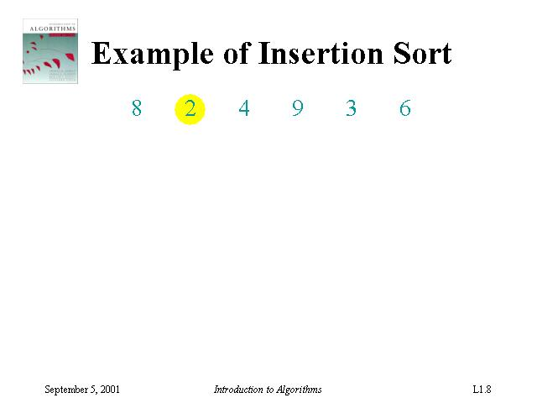
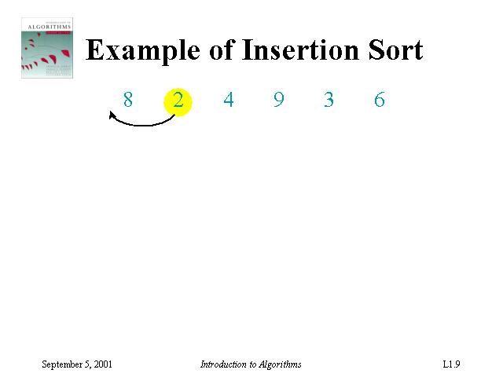
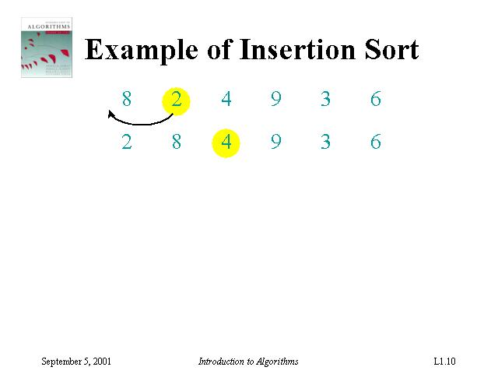
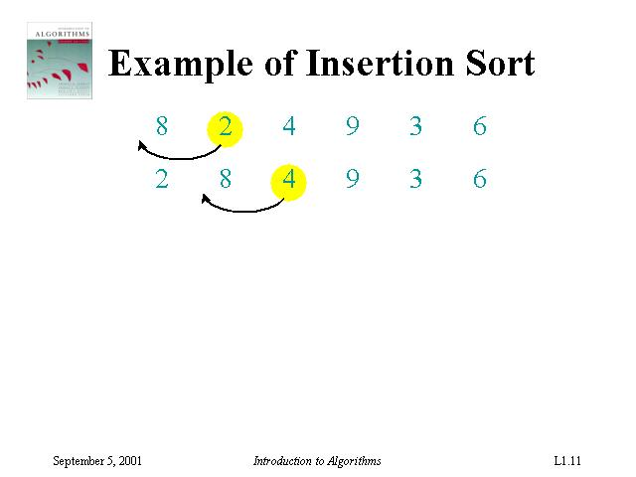
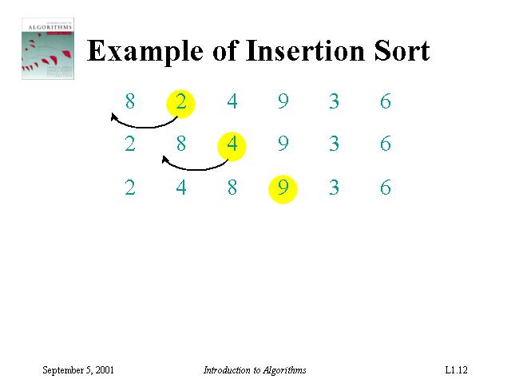
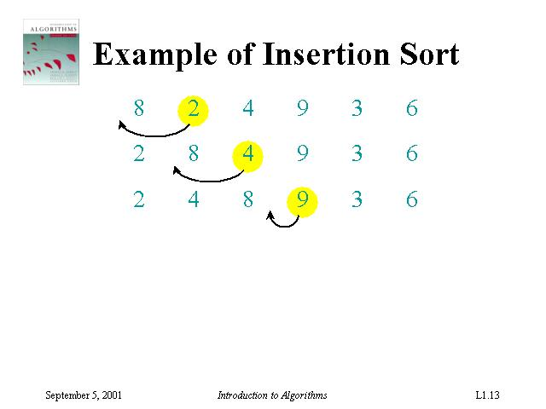
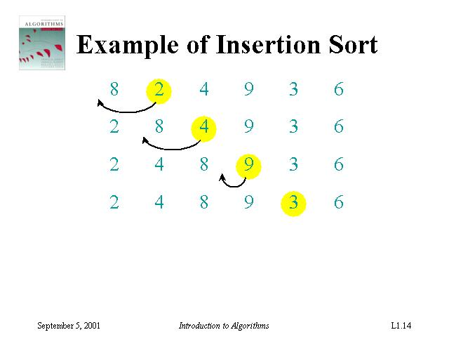
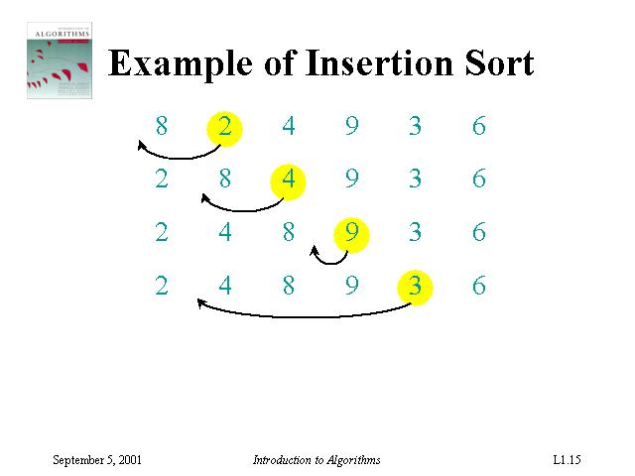
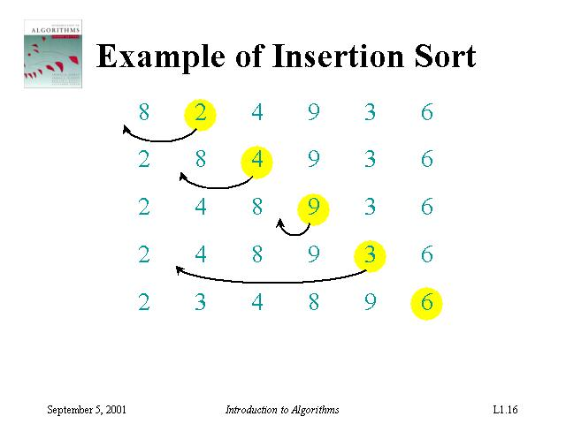
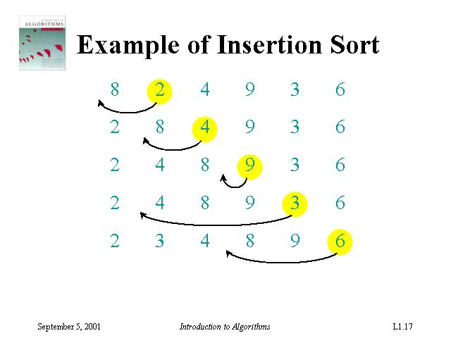
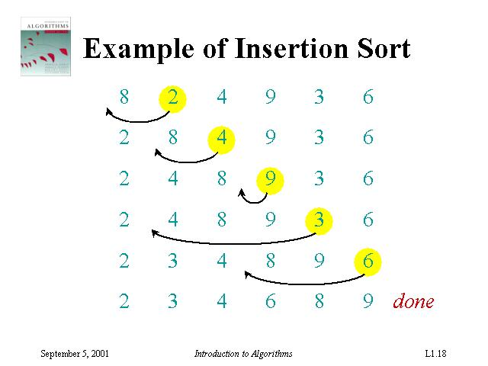

Slide 5
Input numbers (Array A) is Sorted in place :
The numbers are rearranged within the array A, with at most a constant number of them sorted outside the array at any time.
Loop invariant :
Conditions and relationships that are satisfied by the variables and data structures at the start (or end) of each iteration of the loop
e.g., At the start of each iteration of the “outer” for loop of line 1-8, the subarray A[1..j-1] consists of the elements originally in A[1..j-1] but in a sorted order.
Correctness of algorithm:
Using loop invariant
Similar to the math induction
Initialization, maintenance, termination

Slide 6
2.2 Analyzing algorithms
Analyzing an algorithm: predicting the resources that the algorithm requires.
Resources: memory, communication, bandwidth, logic gate, time.
Assumptions: one processor, random-access machine RAM (how real computers are designed)
Instructions are executed one after another (NO concurrent operations)
Use common instructions (assume each one takes a constant amount of time): Arithmetic (+, -, *, /, mod, floor, ceiling, shift right/left), data movement (load, store, copy), control (if..else, case)
Uses integer and floating-point types
Never mind precisions
Limit on the word size: inputs of size n, assume integers are represented by c lg n bits (lg n means log₂ n)

Slide 7
Analyzing Running Time
How to analyze an algorithm’s running time?
Time taken by an algorithm depends on the input
The input size depends on the problem
# items, # bits required, more than one input
The running time (complexity) of an algorithm on a particular input is the number of primitive operations or “steps” executed.
It is convenient to define the notion of step so that it is as machine-independent as possible

Slide 8
Analysis on # Steps
Single operation:
A[5]=2
If (x < y) then …..
A=A+B*C
Loops:
i=0;
while (i<n) do
{ i++; B=B+i; }
for i= 1 to m do
{ B=B+i; }
Constant Time
i=a;
while (i<=b) do
{ XXXX;
i++; }
for i= a to b do
{ XXXX; }
{inside} has been executed for n times, but
while has been executed one more time
{inside} has been executed for m times, but
for has been executed one more time

Slide 9
Running Time of Insertion-Sort
INSERTION-SORT(array A)
1 for j=2 to length[A]
2 do key=A[j]
3 // Insert A[j] to the sorted
sequence A[1..j-1].
4 i=j-1
5 while i>0 and A[i]>key
6 do A[i+1]=A[i]
7 i=i-1
8 A[i+1]=key
Cost Best Worst
c₁ n n
c₂ n-1 n-1
0 n-1 n-1
c₄ n-1 n-1
c₅ n-1
c₆ 0
c₇ 0
c₈ n-1 n-1
t_{j}: the number of times the while loop test in line 5 is executed for the value of j.

Slide 10
Complexity of Insertion-Sort
Best case: Array A is already sorted in non-decreasing order: t_{j}=1
Worst case: Array A is already sorted in non-increasing order: t_{j}=j
Best-case analysis may be misleading

Slide 11
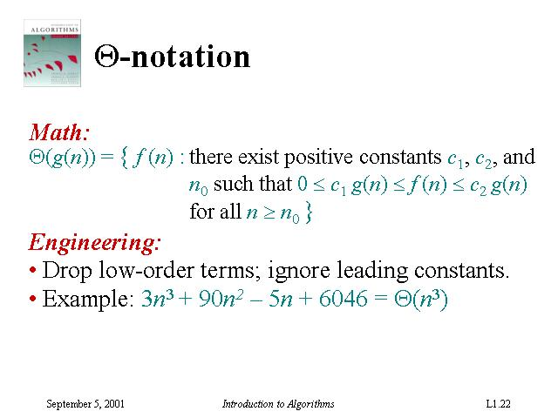

Slide 12
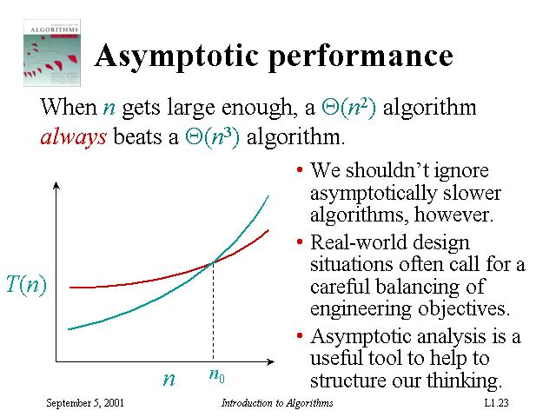

Slide 13
Worst-case and Average-case Analysis
Average-case: require probability analysis
Usually, we focus on finding only on the worst-case running time
Reason:
It is an upper bound on the running time
The worst case occurs fair often
The average case is often as bad as the worst case.
For example, the insertion sort with t_{j}=j/2.
Again, a quadratic function although with smaller coefficient.

Slide 14
Order of Growth
In some particular cases, we shall be interested in average-case, or expected running time of an algorithm. (Chap 5)
It is the rate of growth, or order of growth, of the running time that really interests us.
Only look at the leading terms (drop lower-order terms)
Ignore the constant coefficient in the leading term
e.g., insertion sort:
More on this topic will be taught in Chap 3

Slide 15
2.3 Designing Algorithms
There are many ways to design algorithms:
Incremental approach: insertion sort
Divide-and-conquer: merge sort
recursive:
divide
conquer
combine (merge) ← key procedure
MERGE-SORT (A[1..n])
If n=1, done!
Recursively sort 2 lists: A[ ] and A[ ]
Merge the 2 sorted lists

Slide 16
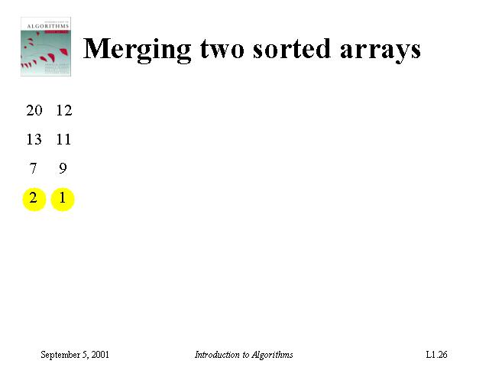
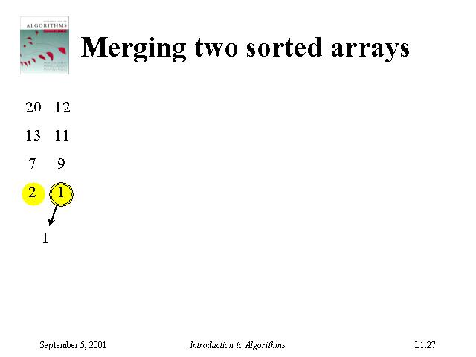
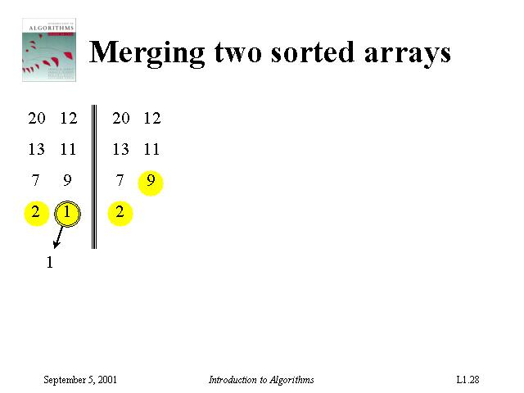
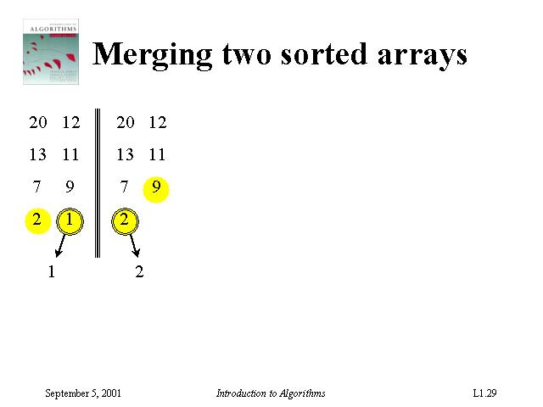
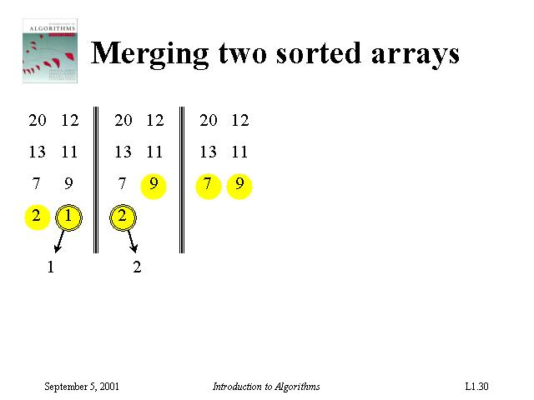

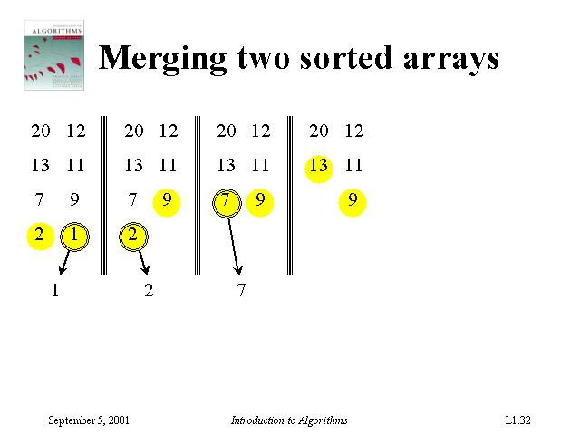
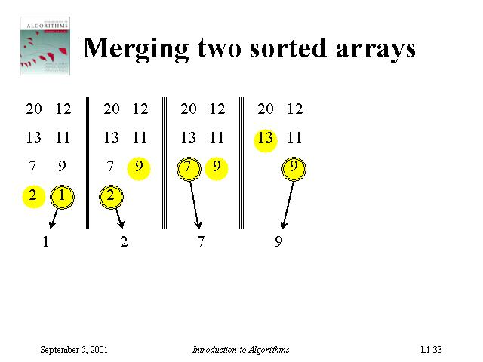
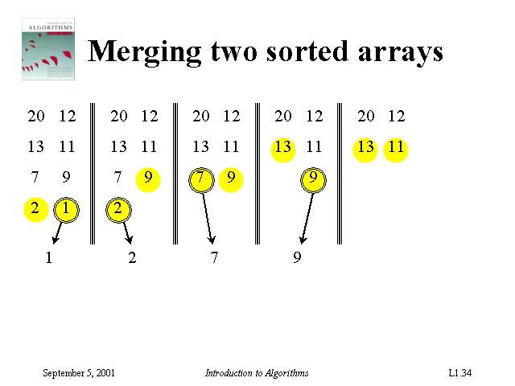
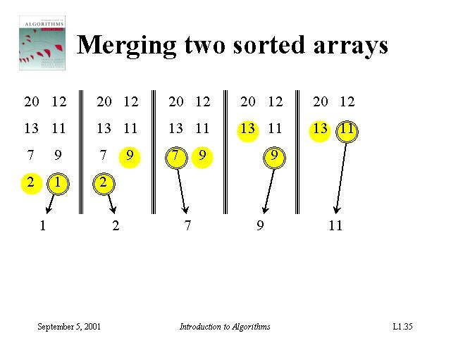
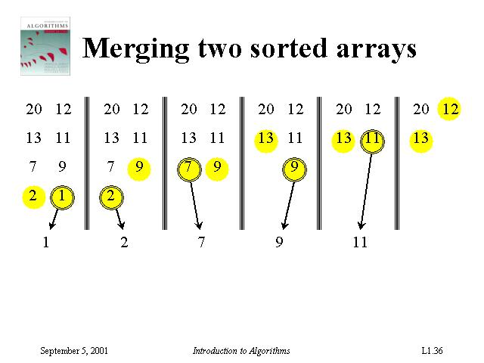
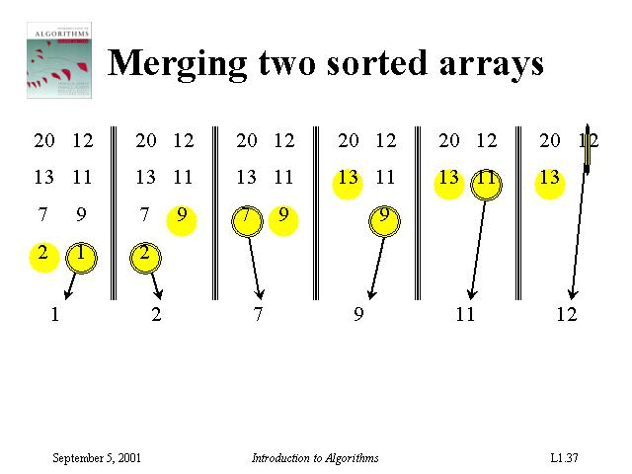
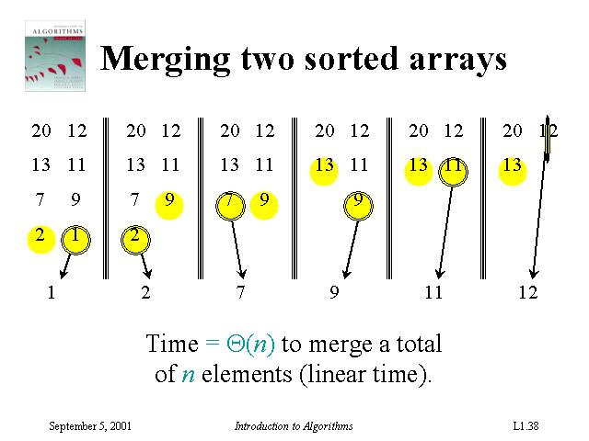

Slide 17
Merge Sort Algorithm
MERGE(A, p, q, r)
1 n₁ = q – p + 1
2 n₂ = r – q
3 // create arrays L[1.. n₁+1] and R[1.. n₂+1]
4 for i=1 to n₁
5 do L[i]=A[p+i – 1]
6 for j=1 to n₂
7 do R[j]=A[q+j]
8 L[n₁+1] = ∞
9 R[n₂+1] = ∞
10 i=1
11 j=1
12 for k=p to r
13 do if L[i] <= R[j]
14 then A[k] = L[i]
15 i=i+1
16 else A[k] = R[j]
17 j=j+1
p <= q <r; A[p..q] and A[q+1..r] are in sorted order;
merges them to a single sorted A[p..r]
MERGE-SORT(A,p,r)
1 if p<r
2 then q=floor((p+r)/2)
3 MERGE-SORT(A, p, q)
4 MERGE-SORT(A, q+1, r)
5 MERGE (A, p, q, r)
MERGE-SORT(A,1,length[A]) gives the order

Slide 18
An Illustrative Example of MS(A)
To sort A=[5,2,4,7,1,3,2,6]
MS(A,1,8)
q=FL((1+8)/2)=4
MS(A,1,4)
MS(A,5,8)
MG(A,1,4,8)
q=FL((1+2)/2)=1
MS(A,1,1)
MS(A,2,2)
MG(A,1,1,2)
q=FL((1+4)/2)=2
MS(A,1,2)
MS(A,3,4)
MG(A,1,2,4)
1
7
3
q=FL((3+4)/2)=3
MS(A,3,3)
MS(A,4,4)
MG(A,3,3,4)
q=FL((5+8)/2)=6
MS(A,5,6)
MS(A,7,8)
MG(A,5,6,8)
2
6
q=FL((5+6)/2)=5
MS(A,5,5)
MS(A,6,6)
MG(A,5,5,6)
MG(A,1,1,2)
MG(A,3,3,4)
MG(A,1,2,4)
MG(A,5,5,6)
MG(A,7,7,8)
MG(A,5,6,8)
MG(A,1,4,8)
5, 2 ➔ 2, 5
4, 7 ➔(no change)
2, 5, 4, 7 ➔ 2, 4, 5, 7
1, 3 ➔ (no change)
2, 6 ➔ (no change)
1, 3, 2, 6 ➔ 1, 2, 3, 6
2, 4, 5, 7, 1, 2, 3, 6 ➔ 1, 2, 2, 3, 4, 5, 6, 7
4
q=FL((7+8)/2)=7
MS(A,7,7)
MS(A,8,8)
MG(A,7,7,8)
5

Slide 19
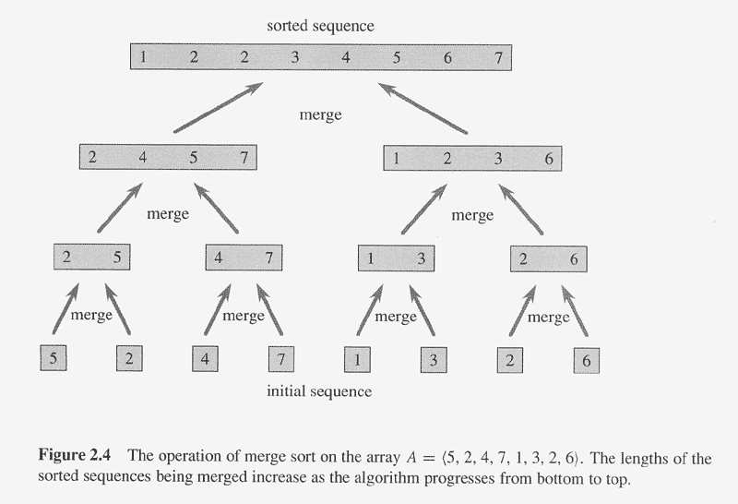

Slide 20
Analyze Divide-and-Conquer Algorithms
Analyzing divide-and-conquer algorithms
a subproblems, each has size 1/b of the original problem, D(n) time to divide, C(n) time to combine See Chapter 4
Analysis of merge sort

Slide 21
Analysis of Merge Sort
Let constant c represents the time require to solve problems of size 1 as well as the time per array element of the divide and combine steps.

Slide 22
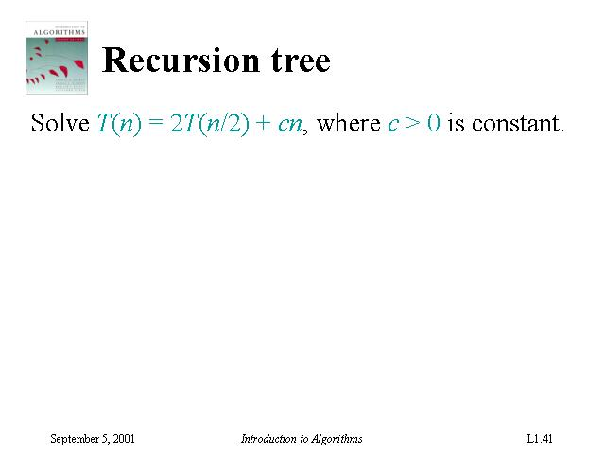
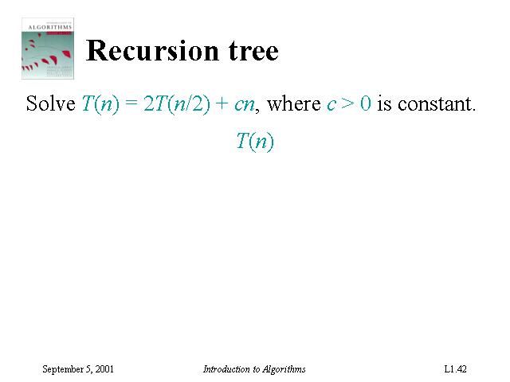
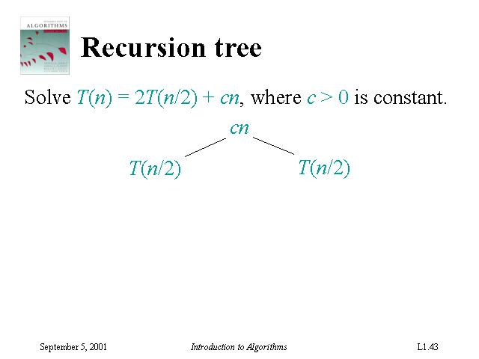
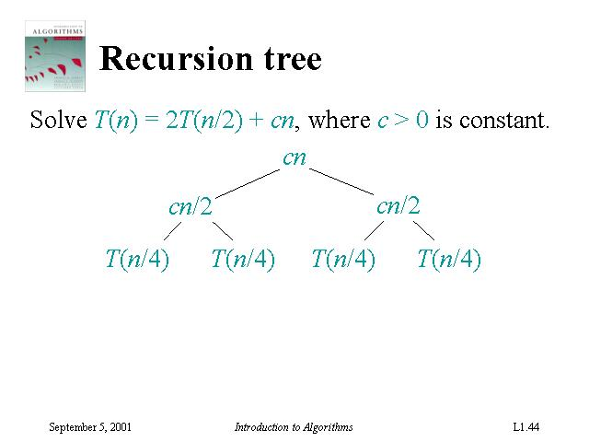
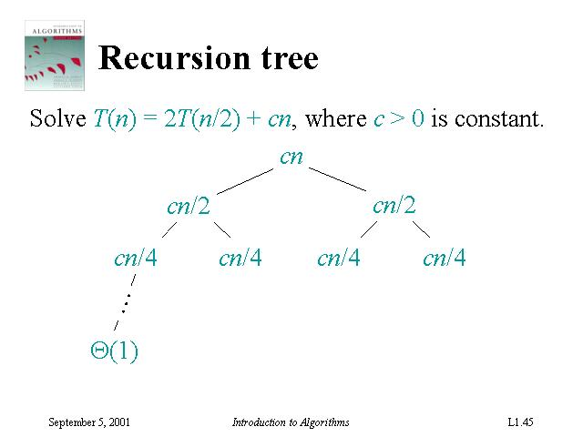
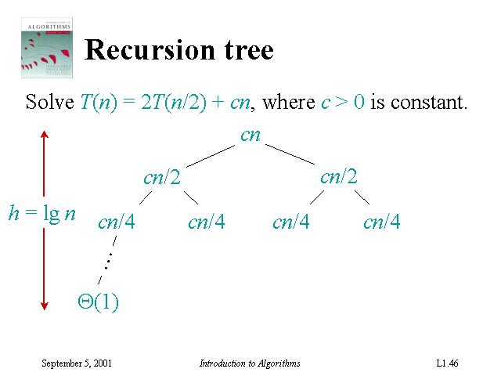
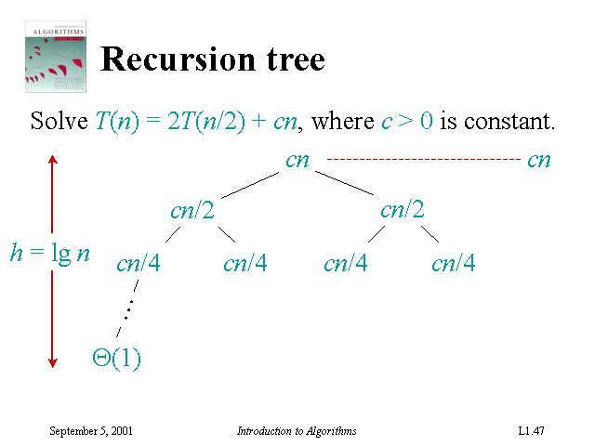
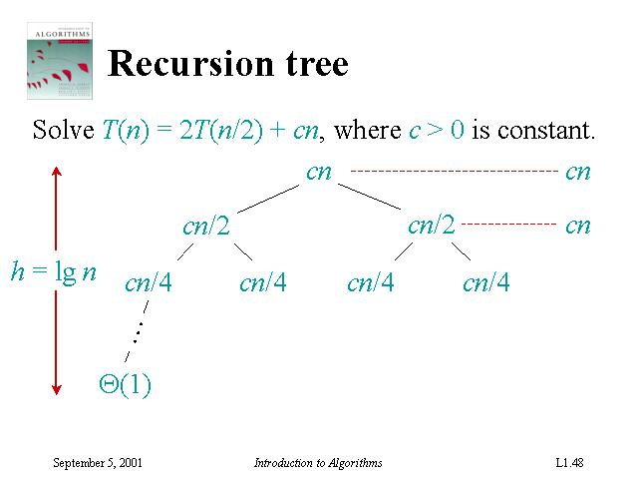

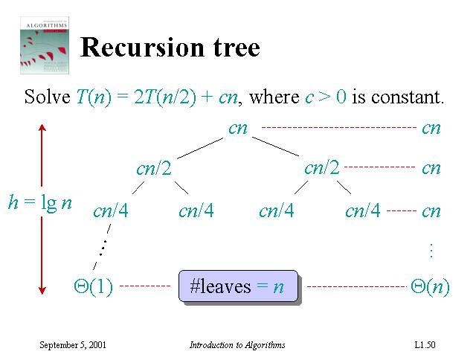
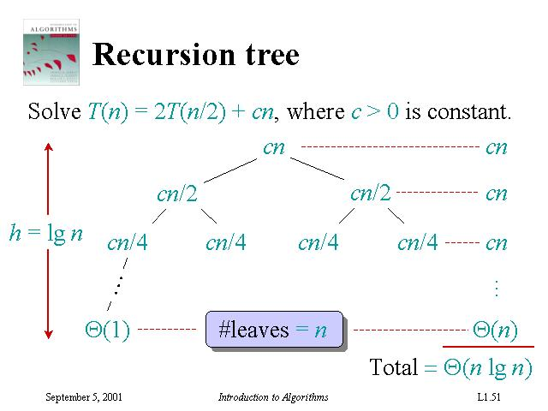

Slide 23
Recursion Tree for Merge Sort
level nodes/ cost/
level level
0 2⁰ = 1 cn
1 2¹ = 2 cn
2 2² = 4 cn
. .
. .
. .
N-1 2^{N-1}=n cn
Since 2^{N-1} = n, lg(2^{N-1}) = lg(n)
levels = N = 1+lg(n)
T(n) = total cost = (levels)*(cost/level)
T(n) = cn [1+lg(n)] = O( n lg(n) )
n nodes at level N-1

Slide 24
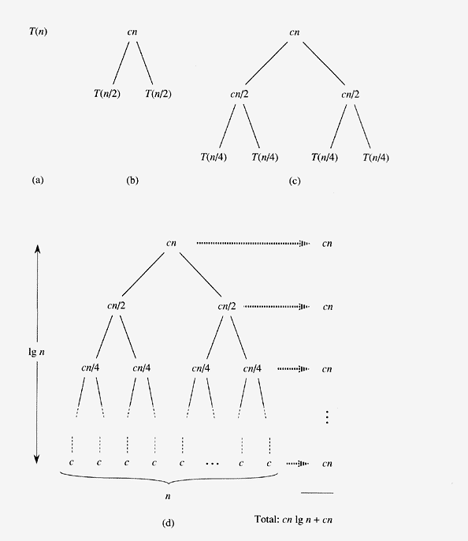
Each level takes cn time
Totally lg n + 1 levels
Thus total time = cn(lg n + 1)
Ignoring coefficient and only keep dominating terms, we got
Asymptotically better than insertion sort
In practice, merge sort beats insertion sort for n>30 or so

